Slide 1
Quantitative Biological Research with Python (92847)
TA 1 – Introduction & Basics

Slide 2
Motivation

Slide 3
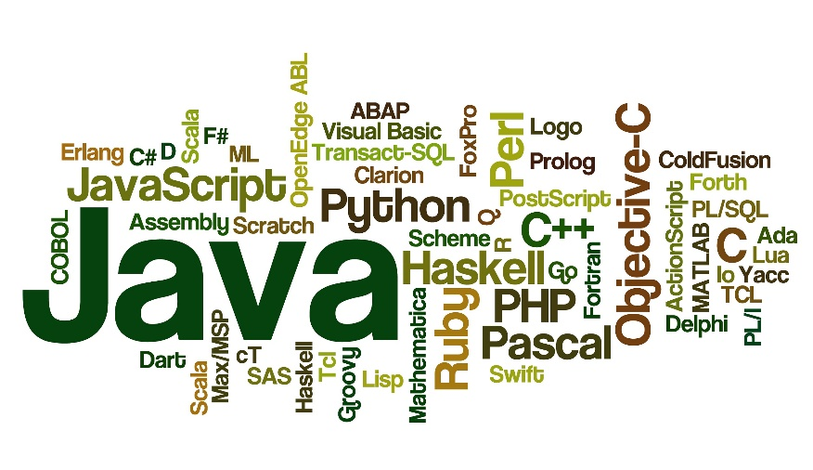
Why programming?
Life is short – automate away daily drudgery
Humans can’t deal with large quantities of data
Off-the-shelf tools will never be flexible enough
Don’t be limited by what others give you
Make your own kind of analysis
Independence
Programming is fun!
"The computer is incredibly fast, accurate, and stupid. Man is incredibly slow, inaccurate, and brilliant. The marriage of the two is a force beyond calculation.“
Albert Einstein Leo Cherne

Slide 4
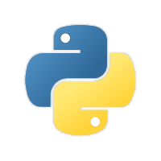
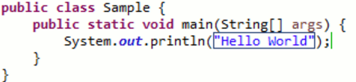


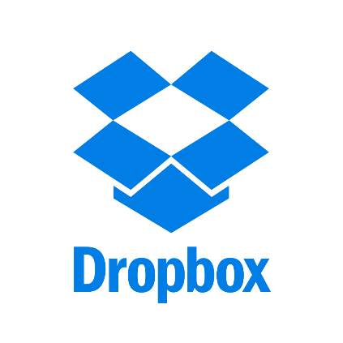
Why Python?
In java:
The language itself
  Simple and elegant
  Dynamic
  Object oriented AND functional
Multipurpose
  Scripting
  Large applications
  Websites
  Research
Ecosystem
  Large active community of developers
  Many great libraries for almost anything
Very popular (taking over data science & bioinformatics)
In Python:

Slide 5
Languages suited for general applications
Languages suited for research
Java
R
Python
C/C++
Matlab
C#

Slide 6
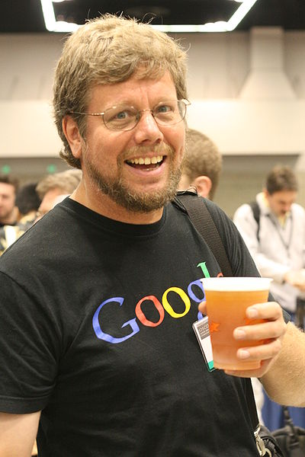
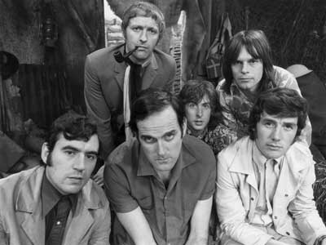
Trivia facts
Named after Monty Python
Was created in 1991 by Guido van Rossum
Python 2.0 was released in 2000, 3.0 in 2008

Slide 7
Let’s get down to that Python business!

Slide 8
Environment
Many ways to run Python:
  Executing .py files
  Shell
    The standard Python shell
    IPython
  IDEs (e.g. Idle, PyDev, Spyder, Komodo)
  Jupyter notebook (AKA IPython Notebook)

Slide 9
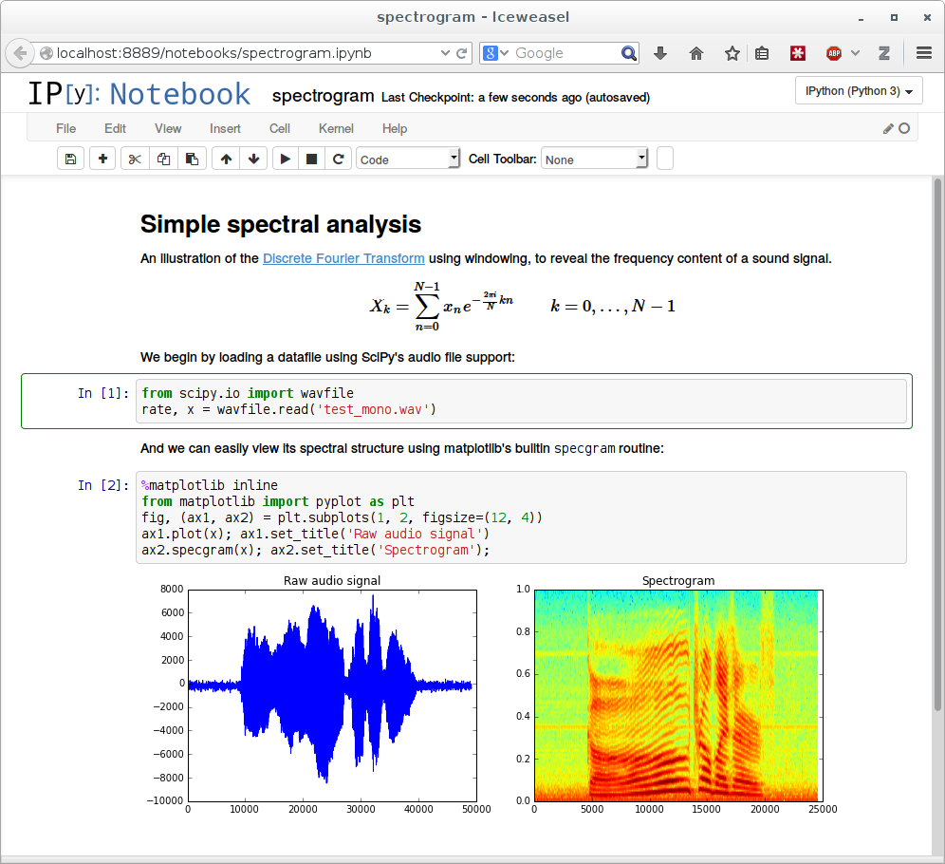
Jupyter Notebook
Originally (2011) called IPython notebook, branched into Jupyter in 2014
An integrated framework for:
  Code
  Text/markup
  Tables, figures, widgets
Runs inside the browser
Python (or other languages) runs in a kernel
Reproducible research

Slide 10
Environment for the course
Recommended to work mostly with Jupyter
  Can also use IPython for small experiments
Write your exercise solutions as notebooks
We’ll learn more Jupyter and IPython features, and touch on more complicated environment topics, later in the course…

Slide 11
Let’s start learning Python!
On today’s menu:
  Variables & types
  Numbers
  Strings
  Conditions & loops
  Lists, tuples, dictionaries & sets

Slide 12
Python 2 vs. 3
Since 2008, Python 3 is available
Python 3 broke some interfaces
Some users still use Python 2 (end of life in 2020)
Current versions: 3.8.0 and 2.7.17
Some notable differences:
  print
  division
  imports
  unicode strings
The __future__ module:

